Slide 1

A Brief Introduction to Fluid Simulation for Computer Graphics
CS 419: Production Computer Graphics
UNIVERSITY OF ILLINOIS AT URBANA-CHAMPAIGN
Eric Shaffer

Slide 2
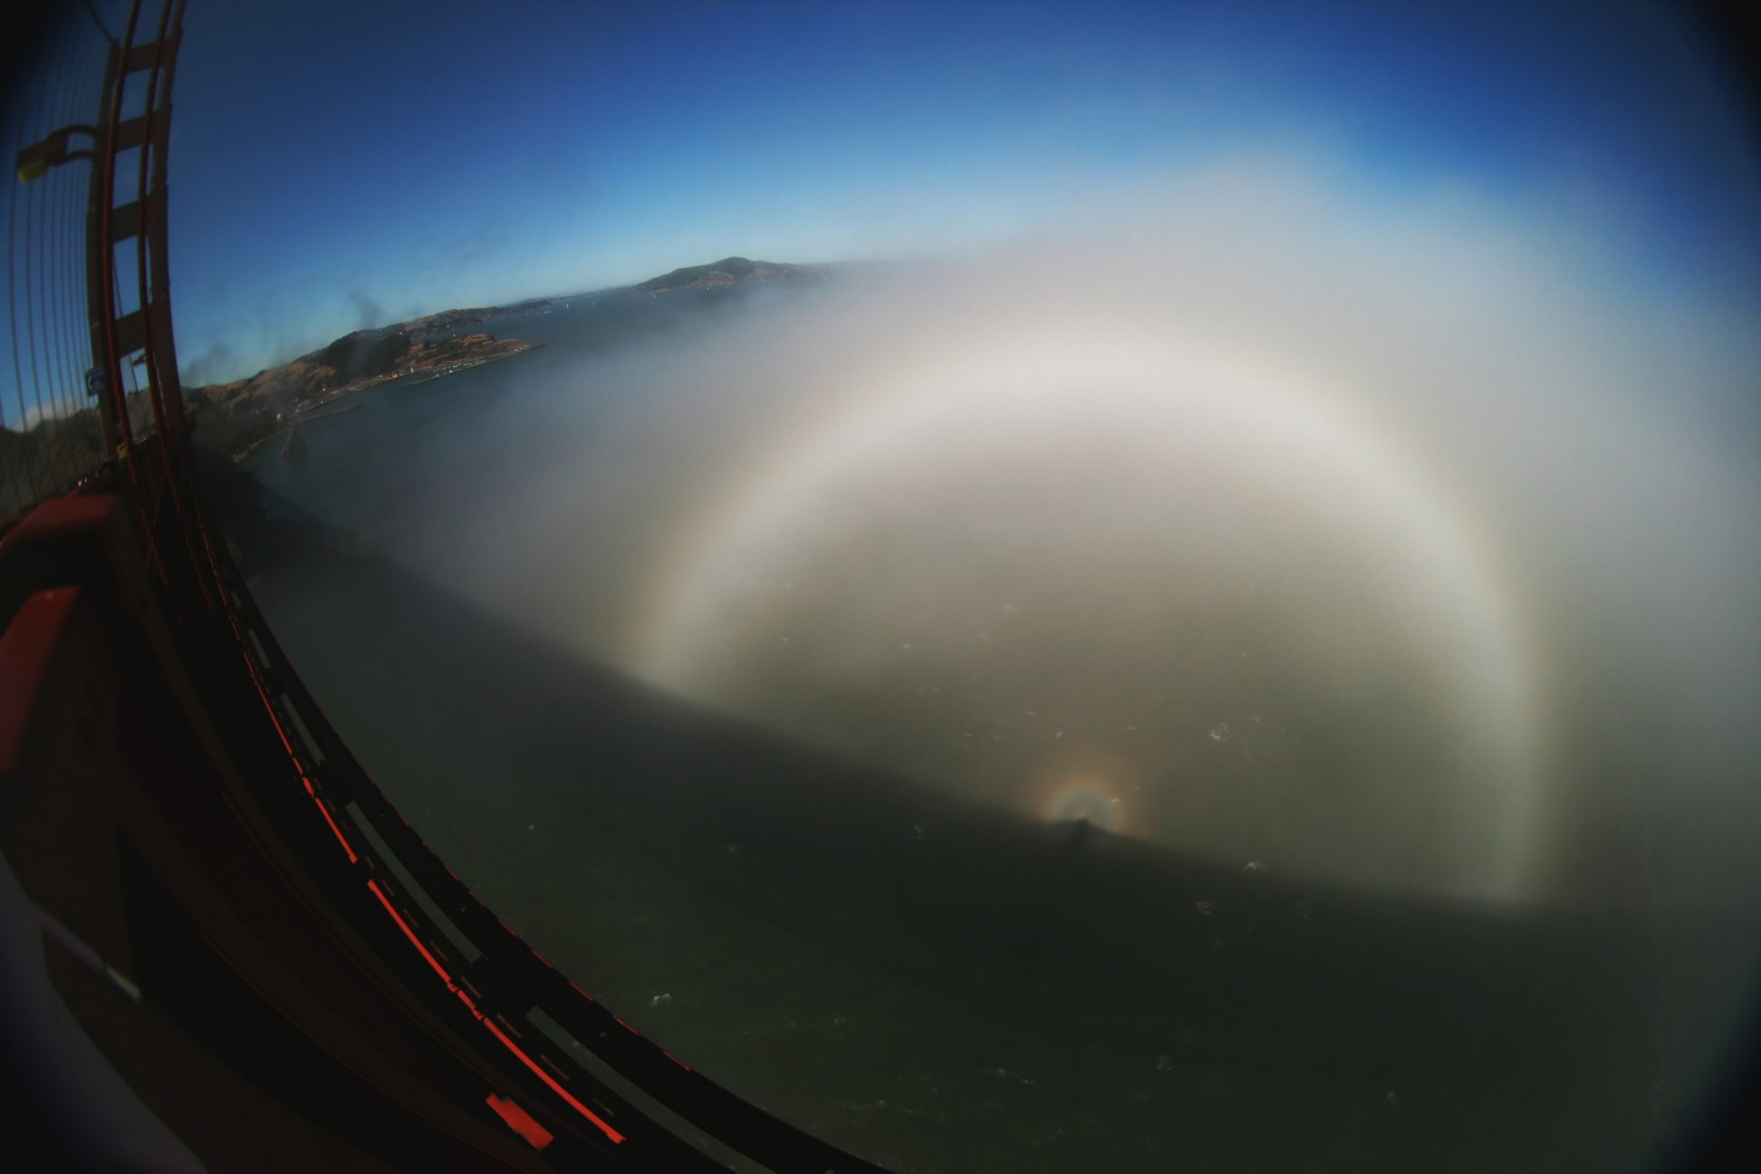
Volumetric Light Scattering: Fogbow
Fogbow

Slide 3


Slide 4
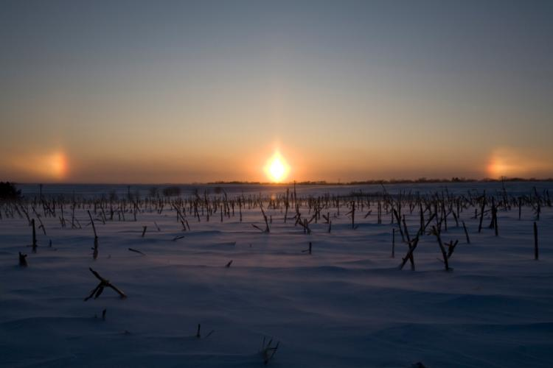
Volumetric Light Scattering: Sun Dogs

Slide 5
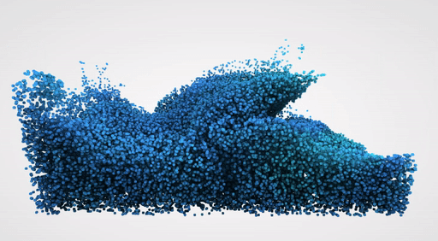
Fluid Simulation

Slide 6

Fluid Simulation
Imagine the fluid is made of particles
We could animate and render the fluid if we knew some function f(t,p) The for any time t could tell us the position of particle p
So…what is that function?

Slide 7
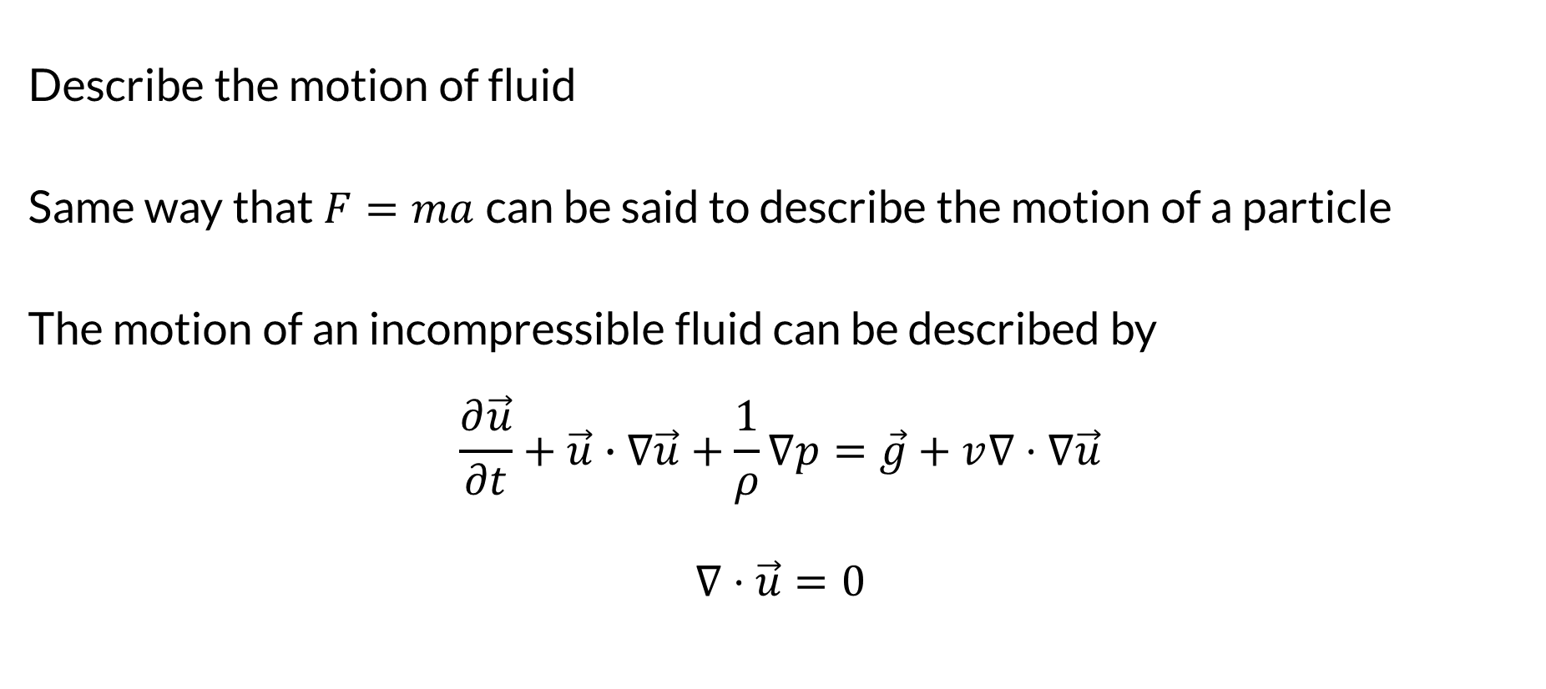
The Navier-Stokes Equations
Describe the motion of fluid
Same way that $F=ma$can be said to describe the motion of a particle
The motion of an incompressible fluid can be described by
$$\frac{∂\vec{u}}{∂t}+\vec{u}∙∇\vec{u}+\frac{1}{ρ}∇p=\vec{g}+v∇⋅∇\vec{u}$$
$$∇⋅\vec{u}=0$$
Can model ocean currents, weather, air flow over a wing…

Slide 8
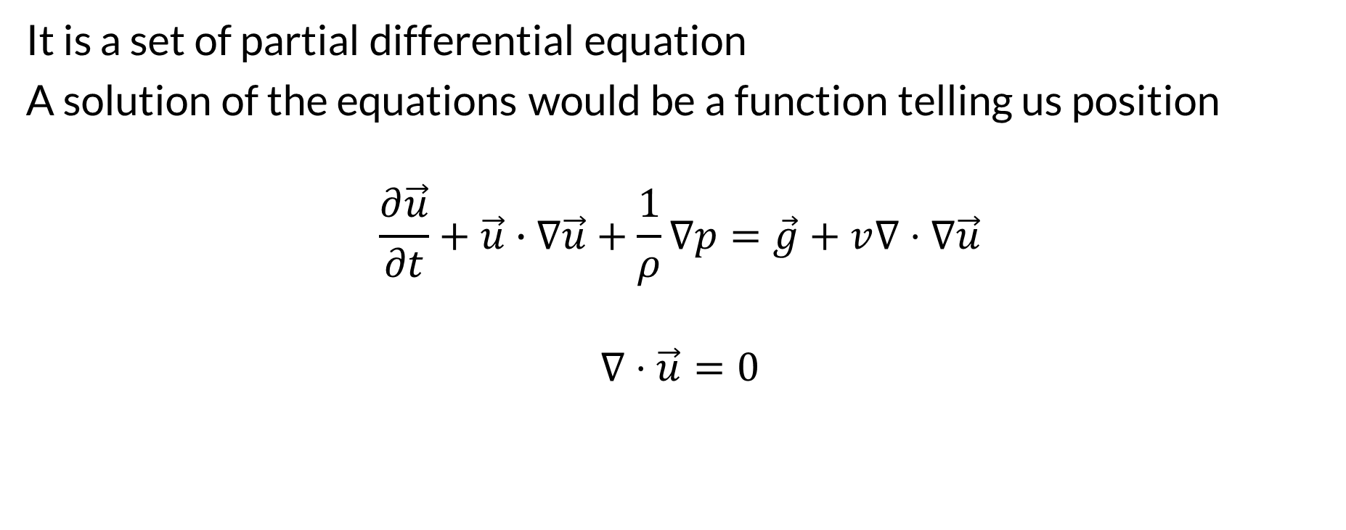
The Navier-Stokes Equations
It is a set of partial differential equation
A solution of the equations would be a function telling us position
$$\frac{∂\vec{u}}{∂t}+\vec{u}∙∇\vec{u}+\frac{1}{ρ}∇p=\vec{g}+v∇⋅∇\vec{u}$$
$$∇⋅\vec{u}=0$$

Slide 9

Gifted (2017) (arguably best Navier-Stokes movie ever)

Slide 10
Very Famous Equations
Despite their wide range of practical uses, it has not yet been proven whether solutions always exist in three dimensions and, if they do exist, whether they are smooth – i.e. they are infinitely differentiable at all points in the domain. These are called the Navier–Stokes existence and smoothness problems. The Clay Mathematics Institute has called this one of the seven most important open problems in mathematics and has offered a US$1 million prize for a solution or a counterexample. -- Wikipedia

Slide 11
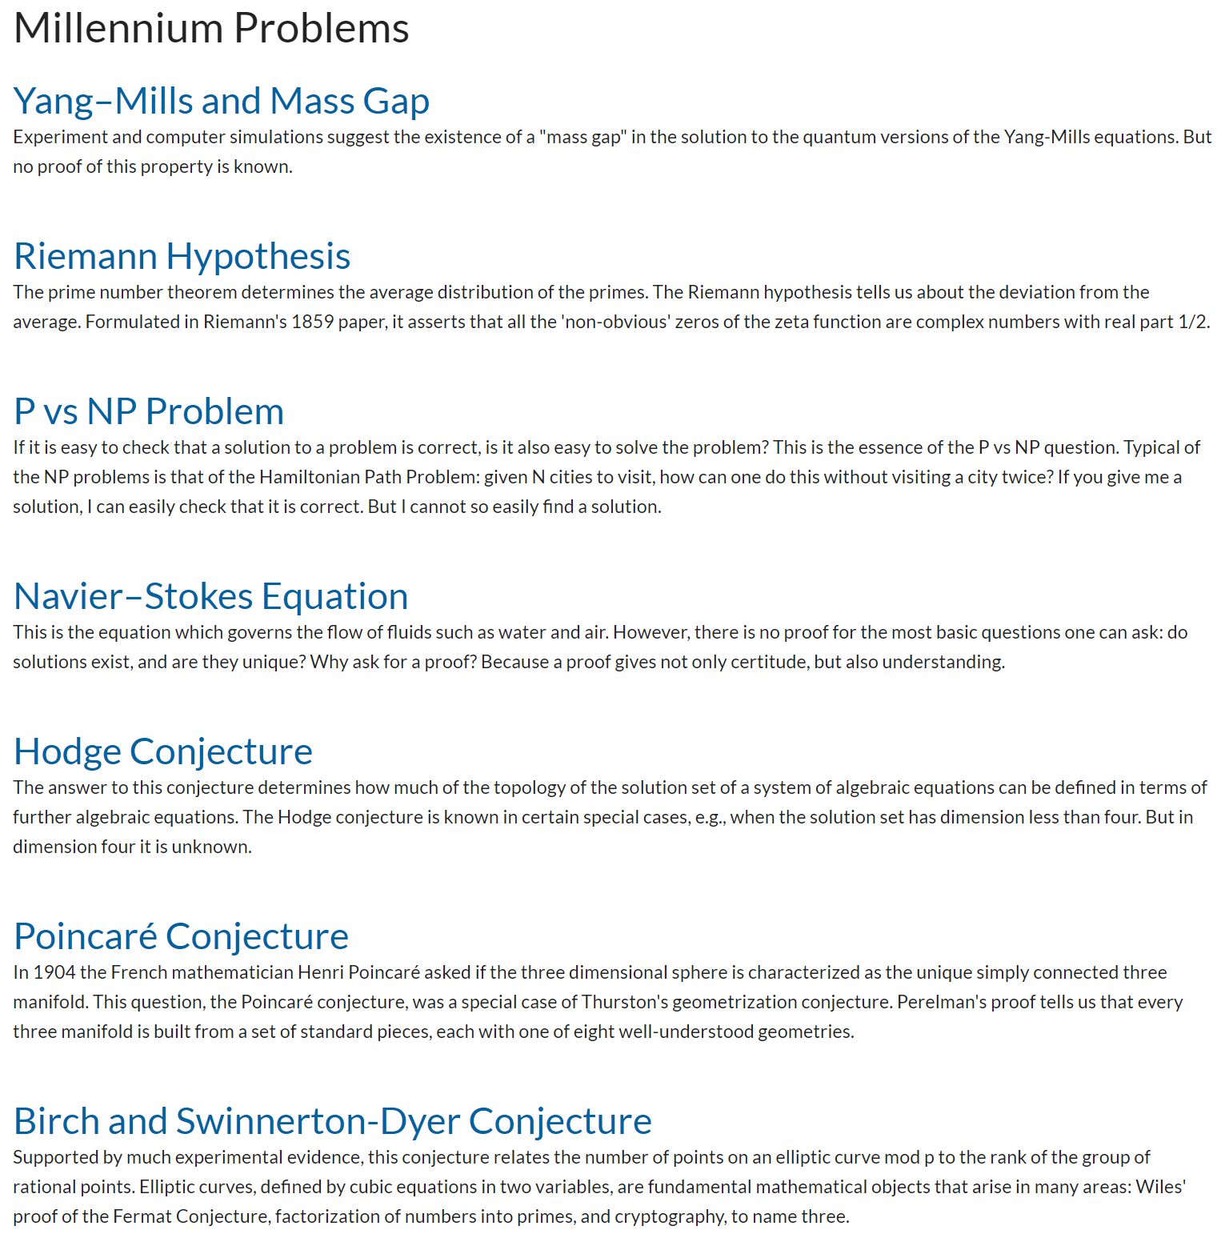
The Poincaré Conjecture was solved by Grigori Perelman in 2003…he declined the prize from the Clay Institute. It remains the only solved Millenium Problem.

Slide 12
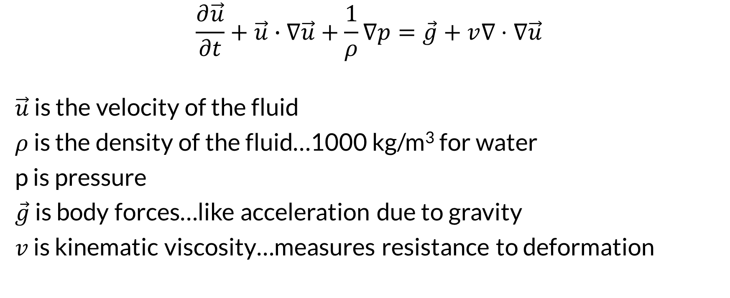
Understanding the Equations
$$\frac{∂\vec{u}}{∂t}+\vec{u}∙∇\vec{u}+\frac{1}{ρ}∇p=\vec{g}+v∇⋅∇\vec{u}$$
$\vec{u}$ is the velocity of the fluid
$ρ$ is the density of the fluid…1000 kg/m³ for water
p is pressure
$\vec{g}$ is body forces…like acceleration due to gravity
$v$ is kinematic viscosity…measures resistance to deformation

Slide 13
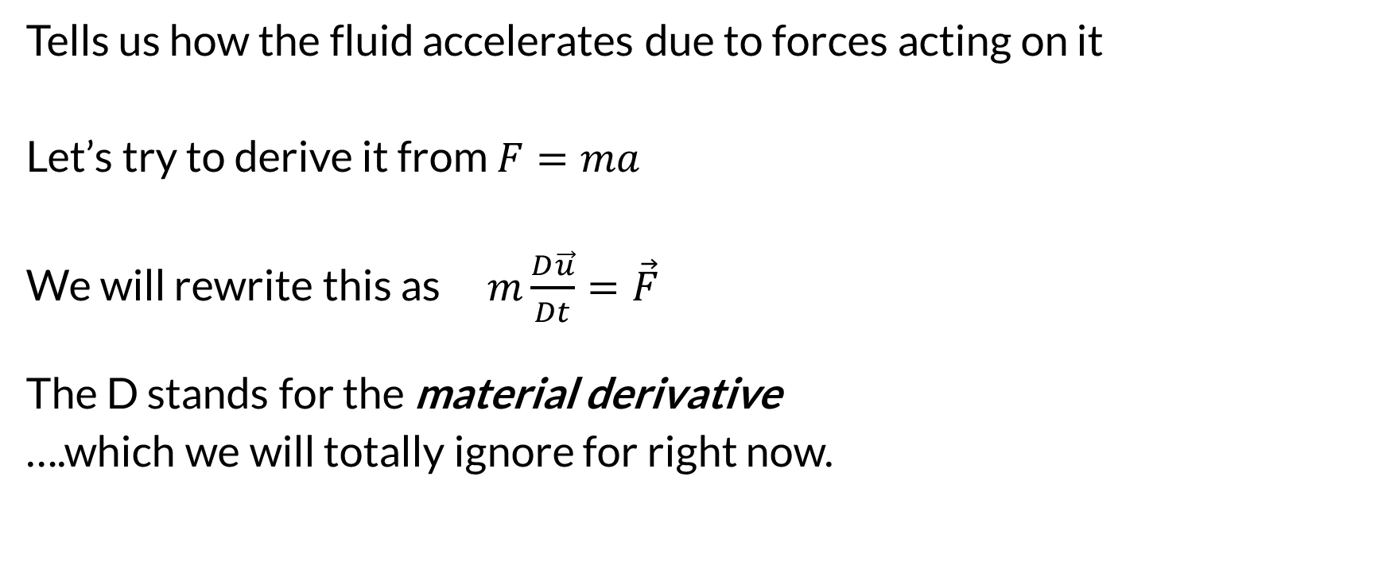
The Momentum Equation
Tells us how the fluid accelerates due to forces acting on it
Let’s try to derive it from $F=ma$
We will rewrite this as $m\frac{D\vec{u}}{Dt}=\vec{F}$
The D stands for the material derivative
….which we will totally ignore for right now.

Slide 14
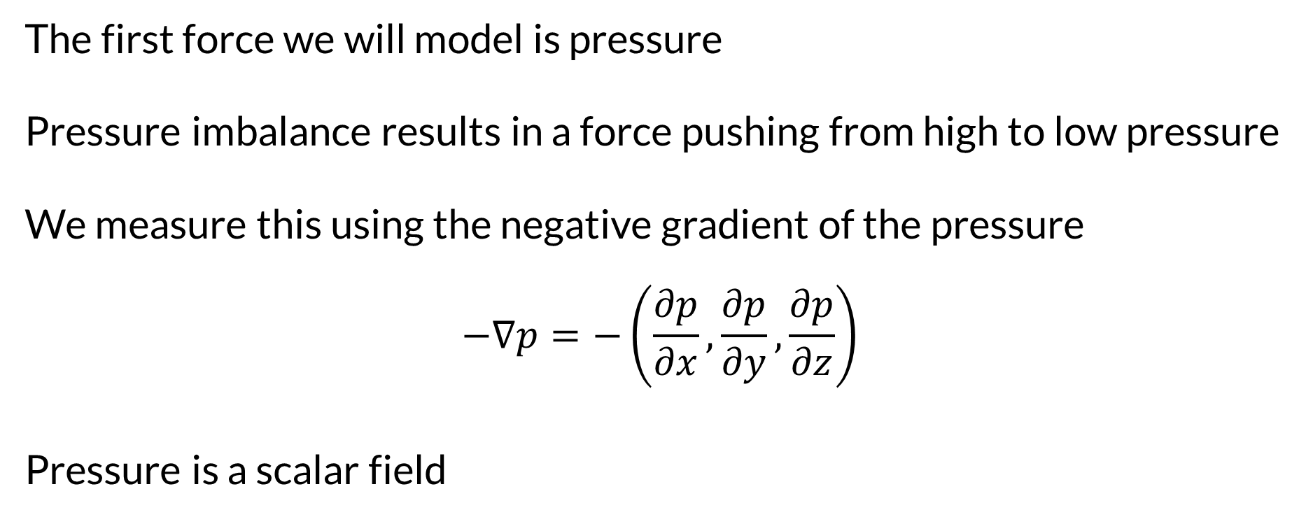
The Momentum Equation: Pressure
The first force we will model is pressure
Pressure imbalance results in a force pushing from high to low pressure
We measure this using the negative gradient of the pressure
$$−∇p=−\left(\frac{∂p}{∂x},\frac{∂p}{∂y},\frac{∂p}{∂z}\right)$$
Pressure is a scalar field

Slide 15
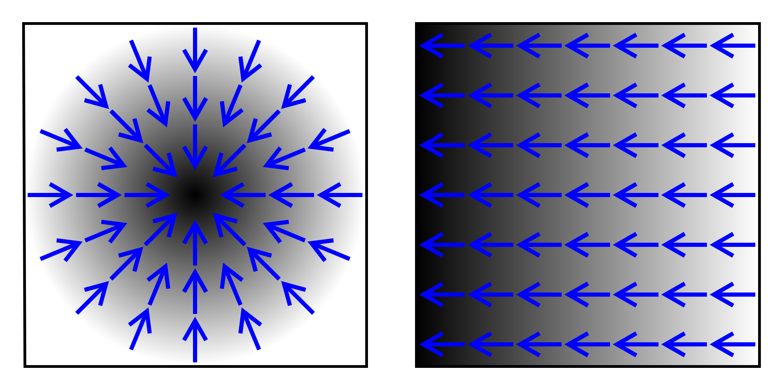
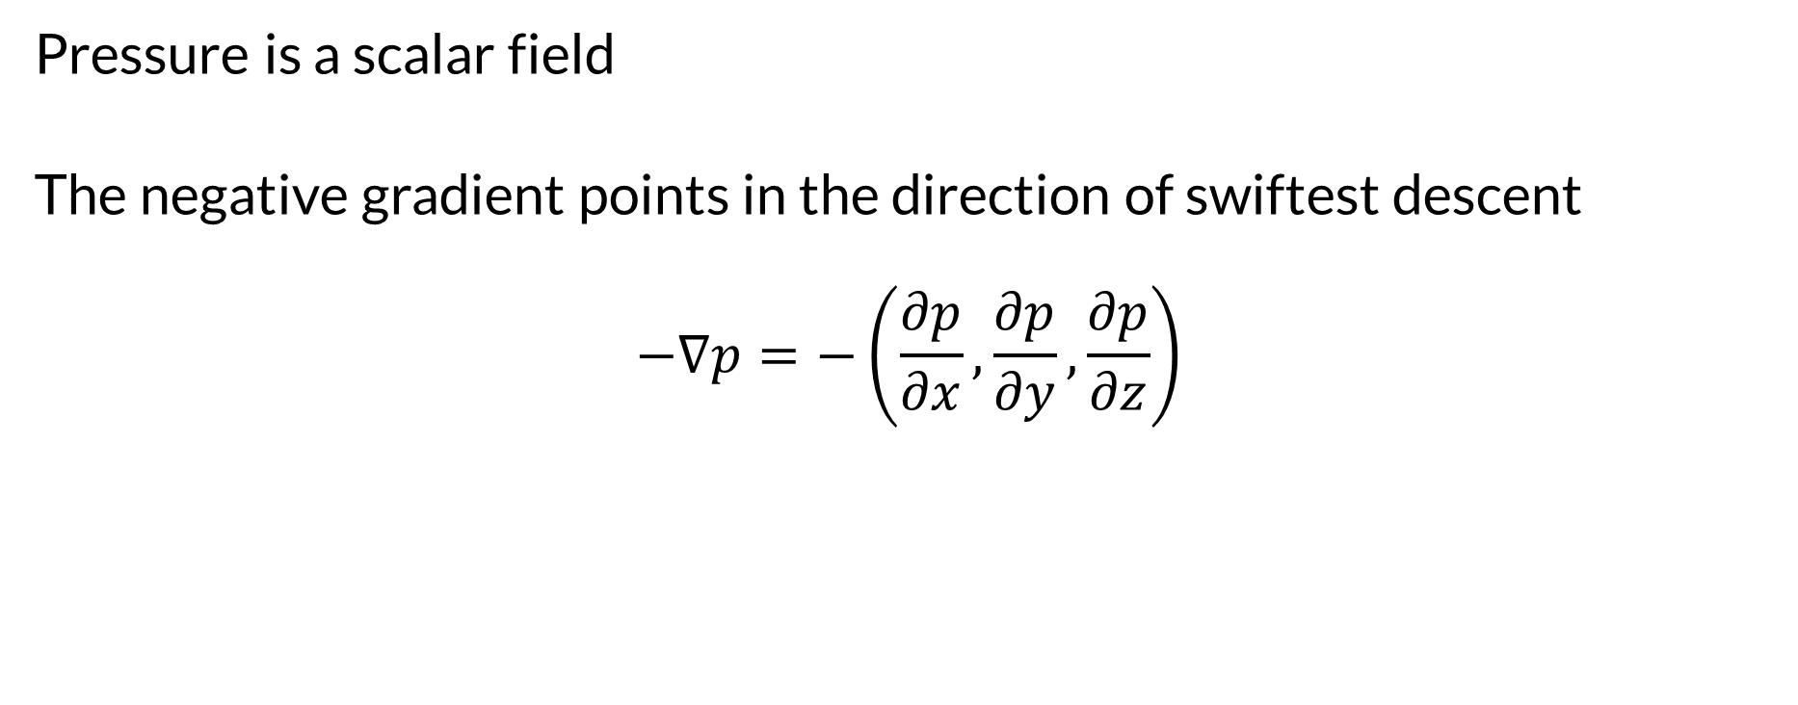
The Momentum Equation: Pressure
Pressure is a scalar field
The negative gradient points in the direction of swiftest descent
$$−∇p=−\left(\frac{∂p}{∂x},\frac{∂p}{∂y},\frac{∂p}{∂z}\right)$$

Slide 16
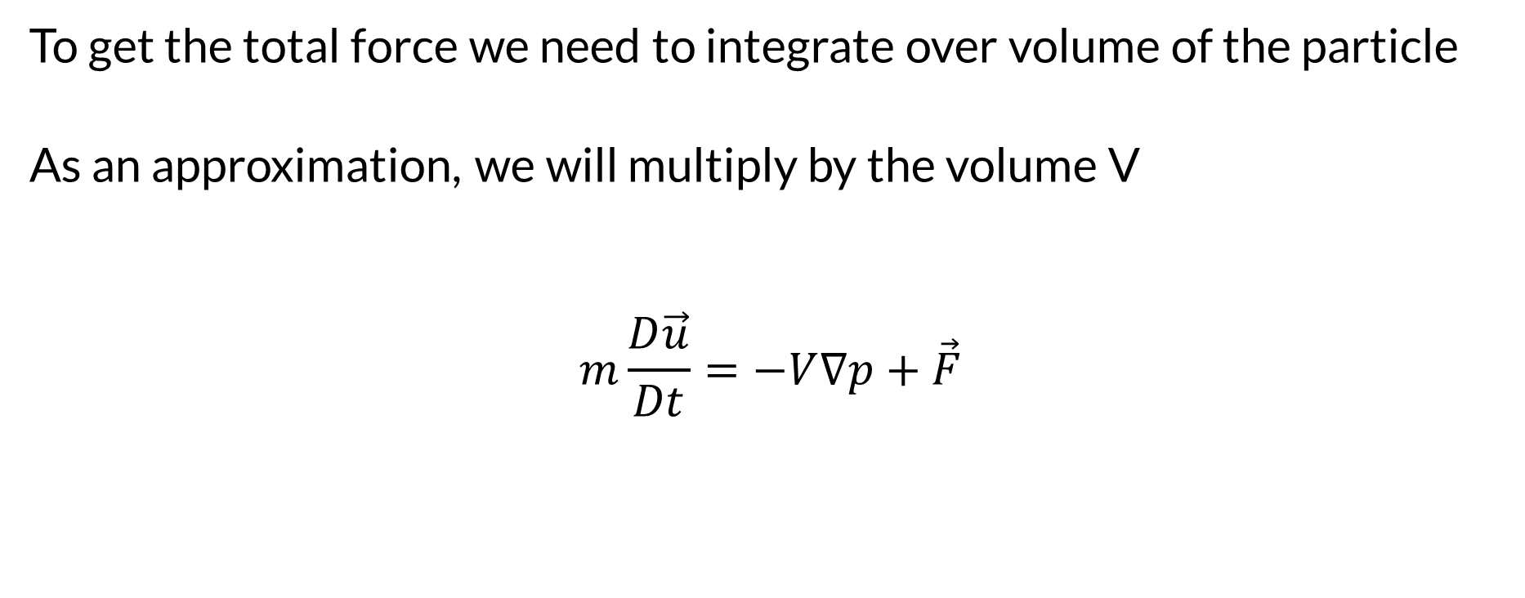
The Momentum Equation: Pressure
To get the total force we need to integrate over volume of the particle
As an approximation, we will multiply by the volume V
$$m\frac{D\vec{u}}{Dt}=−V∇p+\vec{F}$$

Slide 17
The Momentum Equation: Viscosity
Viscosity is another fluid force…it is like friction
A viscous fluid resists deformation
This force tries to make a particle move at same velocity as neighbors
Tries to minimize difference with average velocity of neighbors

Slide 18
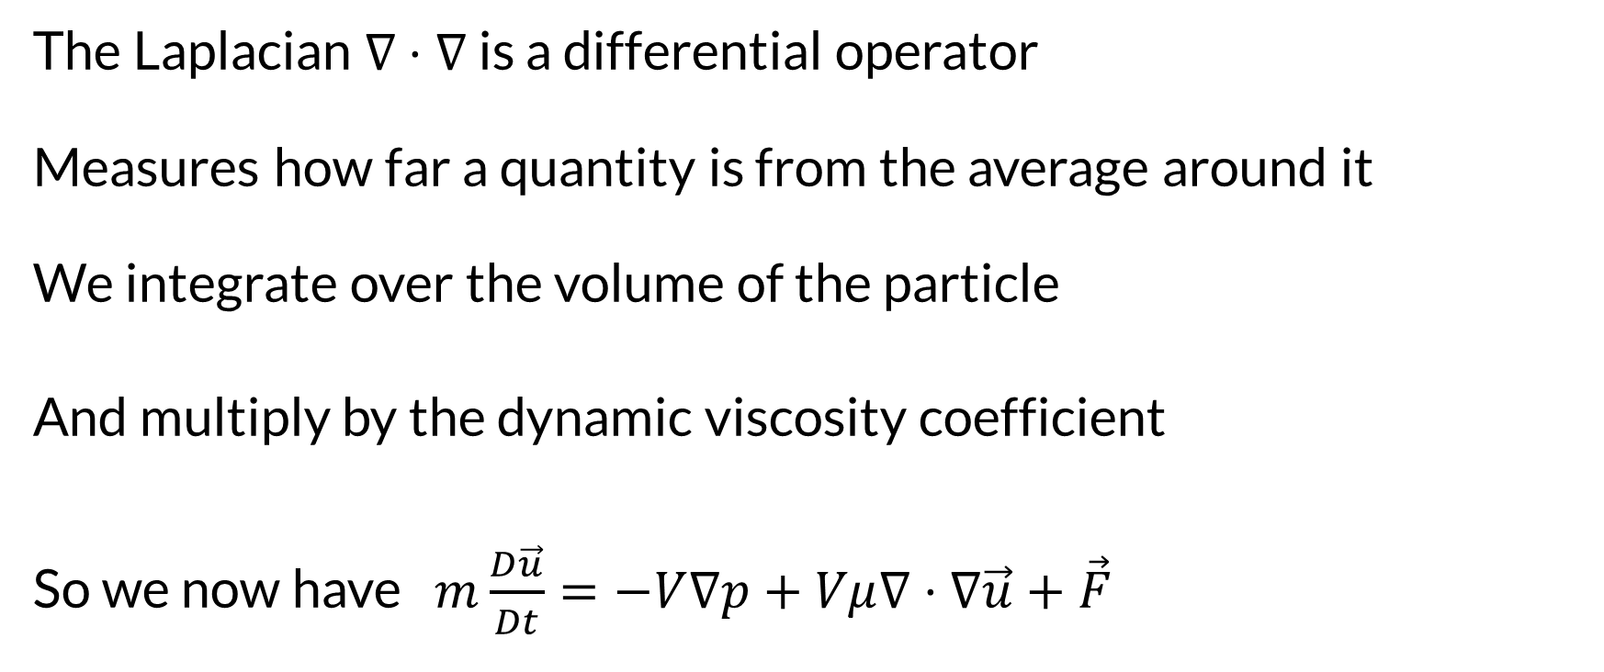
The Laplacian
The Laplacian $∇⋅∇$is a differential operator Measures how far a quantity is from the average around it We integrate over the volume of the particle
And multiply by the dynamic viscosity coefficient
So we now have $m\frac{D\vec{u}}{Dt}=−V∇p+Vμ∇⋅∇\vec{u}+\vec{F}$
Dynamic means we are getting a force out of it, kinematic means we are getting an acceleration

Slide 19
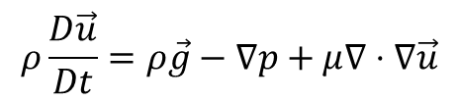
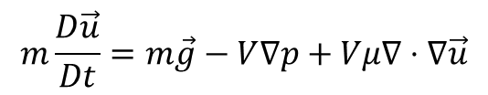
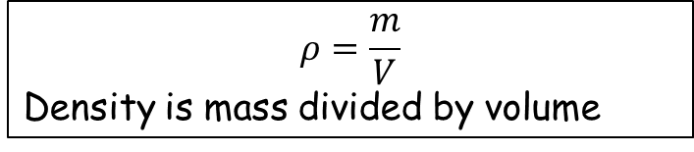
The Momentum Equation: Body Forces
We need to add in the gravitational force…and we’re done
Actually, we’d like to consider a continuum model
Infinite number of particles and particle size approaches 0
Divide the equations by Volume and take the limit
$$m\frac{D\vec{u}}{Dt}=m\vec{g}−V∇p+Vμ∇⋅∇\vec{u}$$
$$ρ\frac{D\vec{u}}{Dt}=ρ\vec{g}−∇p+μ∇⋅∇\vec{u}$$
$$ρ=\frac{m}{V}$$ Density is mass divided by volume

Slide 20
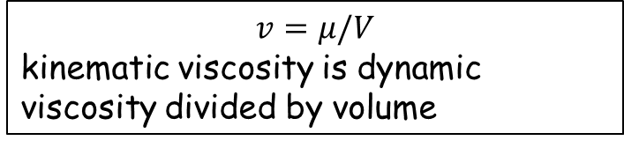
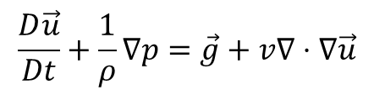
The Momentum Equation
$$\frac{D\vec{u}}{Dt}+\frac{1}{ρ}∇p=\vec{g}+v∇⋅∇\vec{u}$$
Divide by density
$$v=μ/V$$ kinematic viscosity is dynamic viscosity divided by volume

Slide 21
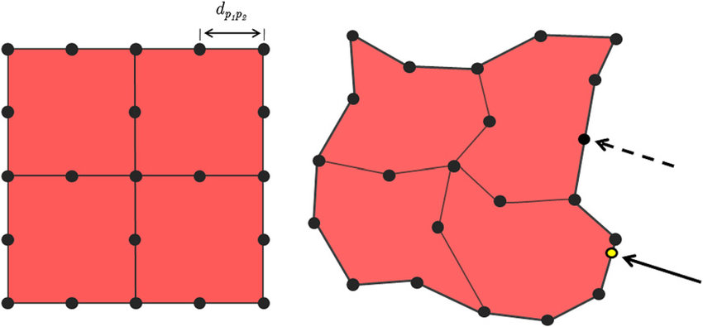
Lagrangian Approach
Fluid is made up of particles
Each particle has a position and velocity
Solid are simulated this way…particles connected as a mesh
Fluids can be as well…

Slide 22
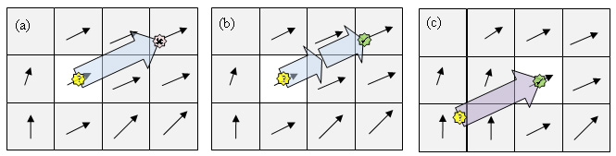
Eulerian Approach
Used for fluids more often
Space is a grid
Measure fluid quantities in grid cells or at grid vertices

Slide 23
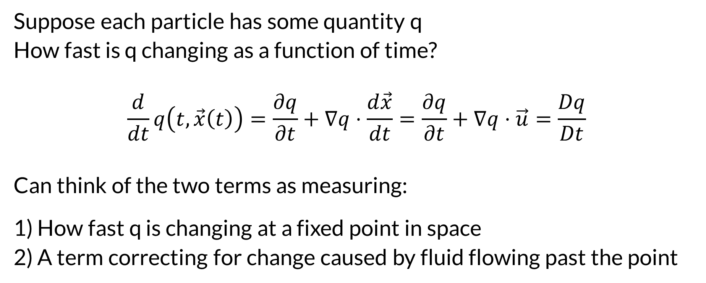
The Material Derivative
Suppose each particle has some quantity q
How fast is q changing as a function of time?
$$\frac{d}{dt}q\left(t,\vec{x}\left(t\right)\right)=\frac{∂q}{∂t}+∇q⋅\frac{d\vec{x}}{dt}=\frac{∂q}{∂t}+∇q⋅\vec{u}=\frac{Dq}{Dt}$$
Can think of the two terms as measuring: 1) How fast q is changing at a fixed point in space
2) A term correcting for change caused by fluid flowing past the point

Slide 24
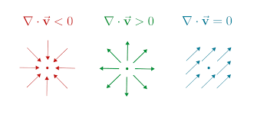
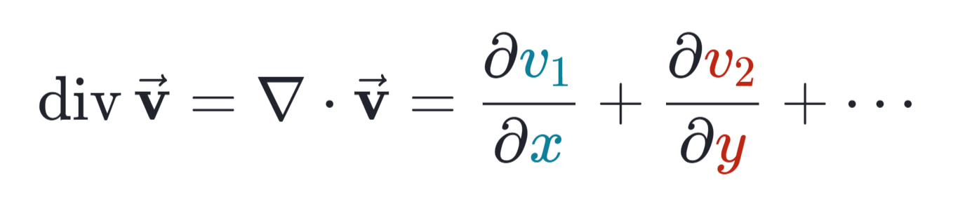
Divergence
In vector calculus, divergence is a vector operator that produces a scalar field, representing the volume density of the outward flux of a vector field from an infinitesimal volume around a given point.
As an example, consider air as it is heated or cooled. The velocity of the air at each point defines a vector field. While air is heated in a region, it expands in all directions, and thus the velocity field points outward from that region. The divergence of the velocity field in that region would thus have a positive value. While the air is cooled and thus contracting, the divergence of the velocity has a negative value.
--Wikipedia

Slide 25
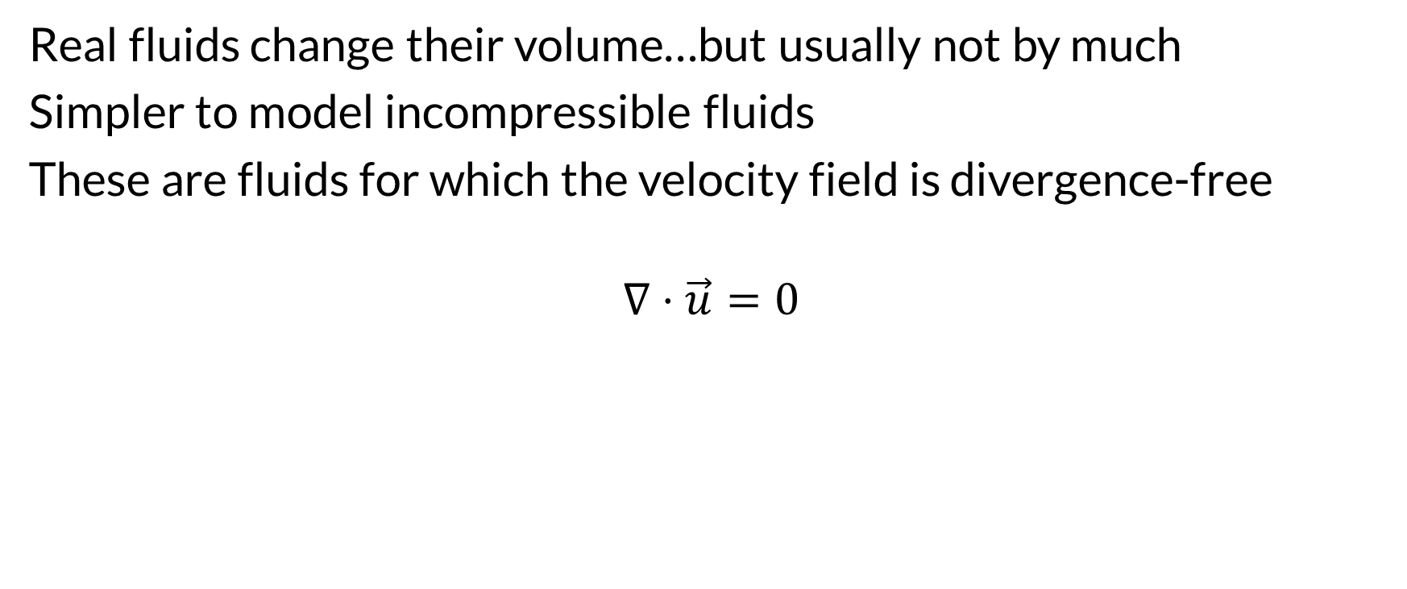
Incompressibility
Real fluids change their volume…but usually not by much
Simpler to model incompressible fluids
These are fluids for which the velocity field is divergence-free
$$∇⋅\vec{u}=0$$

Slide 26
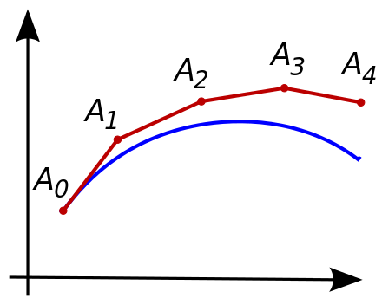
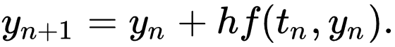
Solving the Equations
The equations are solved numerically
Like using Euler Integration…but more complicated and better methods

